Slide 1
Molecular Dynamics (MD) Overview
Yuan Ping

Slide 2
Outline
R. Lesar, Introduction to Computational Materials Science, ch. 6
What is MD?
The basic MD algorithm
What is MD good for?

Slide 3
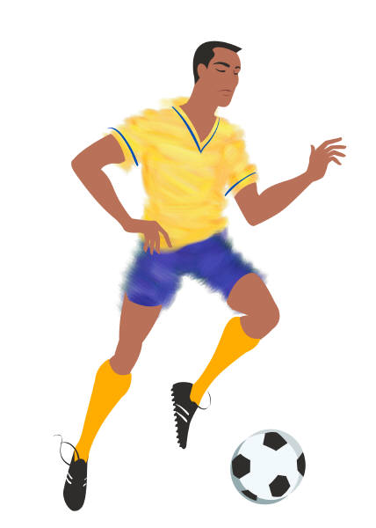
What is MD?
What is Molecular Dynamics?
A technique to move atoms along the paths they should follow according to F=ma (This is called integrating the equations of motion)

Slide 4
What is MD Good For?
Trajectories of atoms (e.g., during collisions, reactions, etc.) – e.g. simulation reaction paths, recrystallization fronts, diffusion paths, or in a non-atomistic context, pool games and planetary orbitals.
Thermodynamic averages
Basic macroscopic properties (e.g., energy, pressure, volume, specific heat, etc.)
Transport coefficients (e.g., diffusion constant, thermal conductivity, etc.)
Vibrational density of states (phonon spectra and beyond)

Slide 5
The Basic MD Algorithm
Start with positions and velocities at time t_{k}: r(t_{k}),v(t_{k})
Find the forces on each particle at t_{k}: F(t_{k})
Find the accelerations of each particle at t_{k}: a(t_{k})
Use r(t_{k}), v(t_{k}), a(t_{k}) to get the correct positions and velocities at t_{k+1} = t_{k} + Δt : r(t_{k+1}), v(t_{k+1})
Iterate this process to evolve the system in time

Slide 6
Goals of A Good MD Algorithm
Accurate
Trajectories: Must give correct trajectories (x(t)) for as long a time as possible (note – don’t get “true” path but do get “shadow” a path from the ensemble)
Averages:
Must give correct microstate probabilities ρ(s) to assures correct time thermodynamic averages <A(s)>
Must give states in correct order (correct time evolution of states) to assure correct time correlation functions <A(t)A(0)>
Accurate with as long a time step δt as possible
Maintain conservation laws from physics
Energy conservation (very important for thermodynamics – both short and long time)
Momentum conservation
Time reversal symmetry (reduces long-time energy drift)
Efficient
Not too much calculation/memory per step (e.g., high-order predictor-corrector methods require many force calculations (slowest part) and slow simulation down without producing a lot of extra accuracy). Two very effective approaches are the Verlet and Velocity Verlet algorithms.

Slide 7
Summary
MD integrates the classical (F=ma) equations of motion.
It can be used to track trajectories (time evolve the system) and perform thermodynamic averages.
The basic MD algorithm finds r(t_{k+1}), v(t_{k+1}) in terms of r(t_{k}), v(t_{k}), and F(t_{k})=ma(t_{k}) and needs to be accurate and efficient.

